Slide 1

REDSPARKS · ENTERPRISE AI
Make complex operations
actually run on AI.
Custom enterprise AI development and production delivery
From business design and product development to integration, production operations and continuous evolution
Sean Liu · Founder & CEO, Redsparks · Kuala Lumpur
Presented in Chinese · Live English interpretation
Notes:
[Sources]
- /Users/liuxue/Documents/Codex/callops-kuala-lumpur-talk/output/callops-kuala-lumpur-talk-cn-v8.2-proof-first-product-view-review.pptx

Slide 2
Redsparks / CallOps
REDSPARKS · CUSTOM ENTERPRISE AI, DELIVERED TO PRODUCTION
We redesign the hardest part of an enterprise operation as an AI system.
Understand the business
Redesign the workflow
Build for the operation
Connect the systems
Deliver to production
Goals, people and decisions
How AI enters daily work
Algorithms, product and data
CRM, PBX, IM and permissions
Launch, monitor and improve
1
→
2
→
3
→
4
→
5
→
6
Diagnose
Design
Build
Integrate
Launch
Evolve
Sean's leadership and project experience includes Watsons China, China Merchants Bank, New Oriental, Shui On Group, Longfor Group and Yuexiu Group.
02
Notes:
[Sources]
- /Users/liuxue/Documents/Codex/callops-kuala-lumpur-talk/output/callops-kuala-lumpur-talk-cn-v8.2-proof-first-product-view-review.pptx

Slide 3
Redsparks / CallOps
DEMAND DISCOVERY · START WITH REAL MANAGEMENT WORK
We followed the owner, supervisors and agents through one full day of management work.
OWNER
×
SUPERVISOR
One sees the result. The other relies on sampling.
AGENT
SYSTEM
WHAT IS MISSING:
MANAGEMENT THAT RUNS
Does not know what to change on the next call
Plenty of data, but it does not become action
The problem is not one missing report. Management cannot be replicated reliably across hundreds of people. So we designed AI from the operating action backwards.
03
Notes:
[Sources]
- /Users/liuxue/Documents/Codex/callops-kuala-lumpur-talk/output/callops-kuala-lumpur-talk-cn-v8.2-proof-first-product-view-review.pptx

Slide 4
THE OWNER QUESTION
The question we heard from the owner was not about an AI feature.
Without depending on a supervisor's daily condition,
how do I get hundreds of agents
to keep doing the right things?
Every owner in this room can answer that question for their own team.
Notes:
[Sources]
- /Users/liuxue/Documents/Codex/callops-kuala-lumpur-talk/output/callops-kuala-lumpur-talk-cn-v8.2-proof-first-product-view-review.pptx

Slide 5
Redsparks / CallOps
OPERATING EVIDENCE · ANONYMISED · MULTI-FACTOR
A stronger management system is already supporting stronger operating results.
10.45%
→
20.63%
CRM outcomes / effective calls
128 → 130
42.10 → 45.29
BETTER RESULTS.
NOT MORE HEADCOUNT.
Active agents
Weighted team QA
Anonymised May–June observation. Multiple management and operating changes contributed; results cannot be attributed to one AI feature.
05
Notes:
[Sources]
- /Users/liuxue/Documents/Codex/callops-kuala-lumpur-talk/output/callops-kuala-lumpur-talk-cn-v8.2-proof-first-product-view-review.pptx

Slide 6
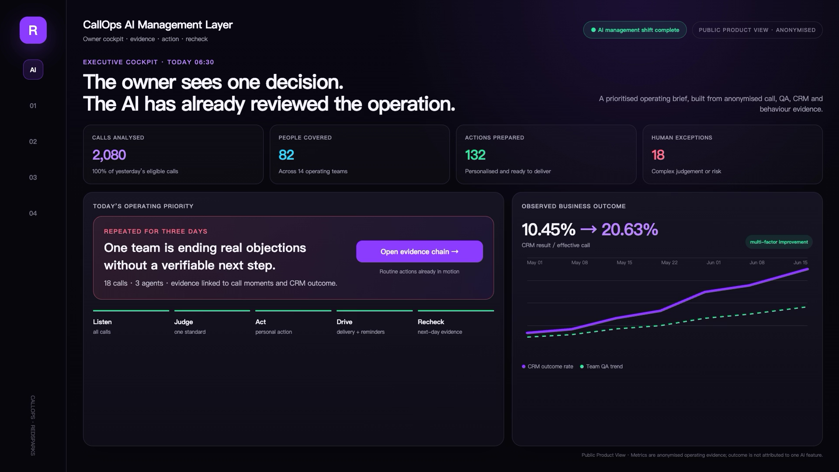
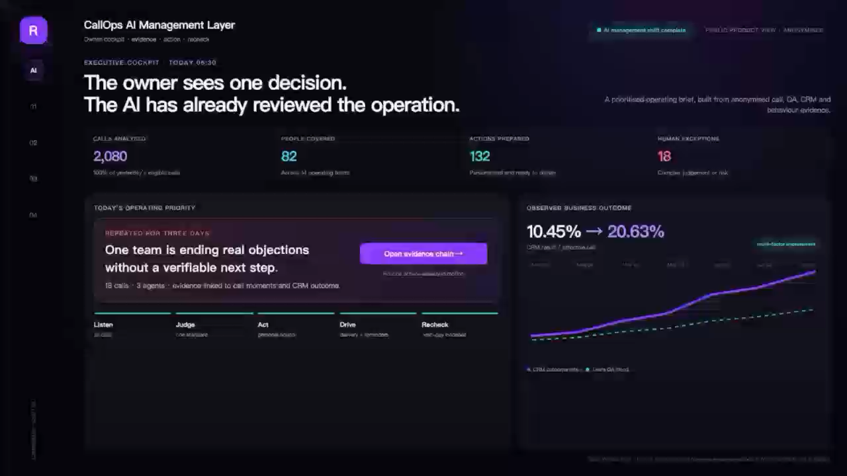
Redsparks / CallOps
90-SECOND DEMO · ONE REAL CAPABILITY PATH
In 90 seconds, see AI move from an operating result to an executed management action.
EMBEDDED VIDEO · CLICK TO PLAY
OPERATING BRIEF → EVIDENCE → PERSONAL ACTION → OWNER APPROVAL → NEXT-DAY RECHECK
06
Notes:
Play the 90-second English video, then continue to slide 7 to open the system evidence.
[Sources]
- /Users/liuxue/Documents/Codex/callops-kuala-lumpur-talk/output/callops-kuala-lumpur-demo-en-v3.1-action-story-review.mp4

Slide 7
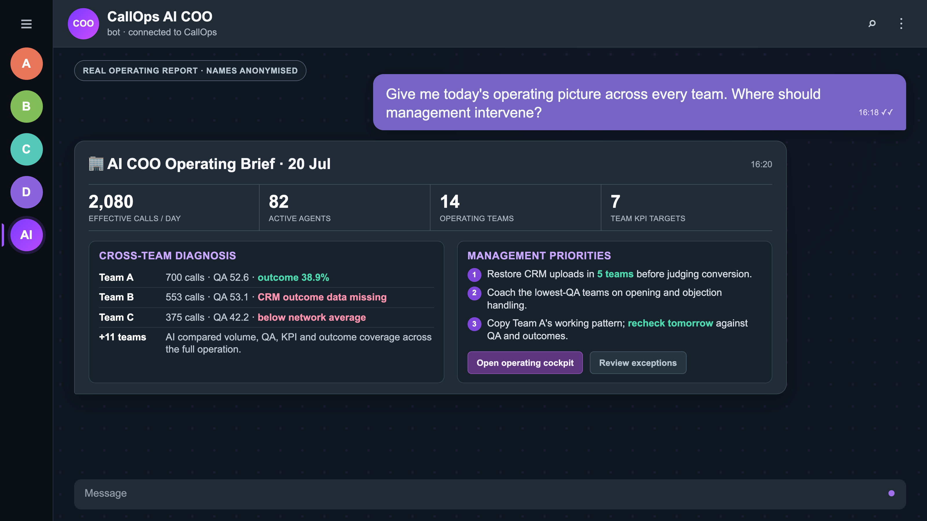
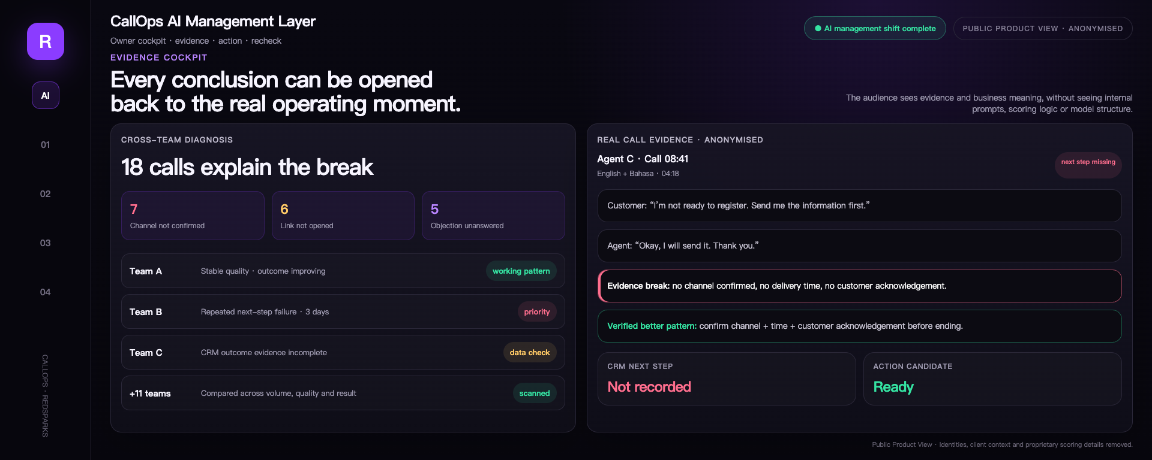
Redsparks / CallOps
EVIDENCE COCKPIT · REAL OPERATING CHAIN
A score is not enough. Trace the issue to the team, the call and the action.
Compare teams
Real calls
CRM outcomes
Action candidates
07
Notes:
[Sources]
- /Users/liuxue/Documents/Codex/callops-kuala-lumpur-talk/output/callops-kuala-lumpur-talk-cn-v8.2-proof-first-product-view-review.pptx

Slide 8
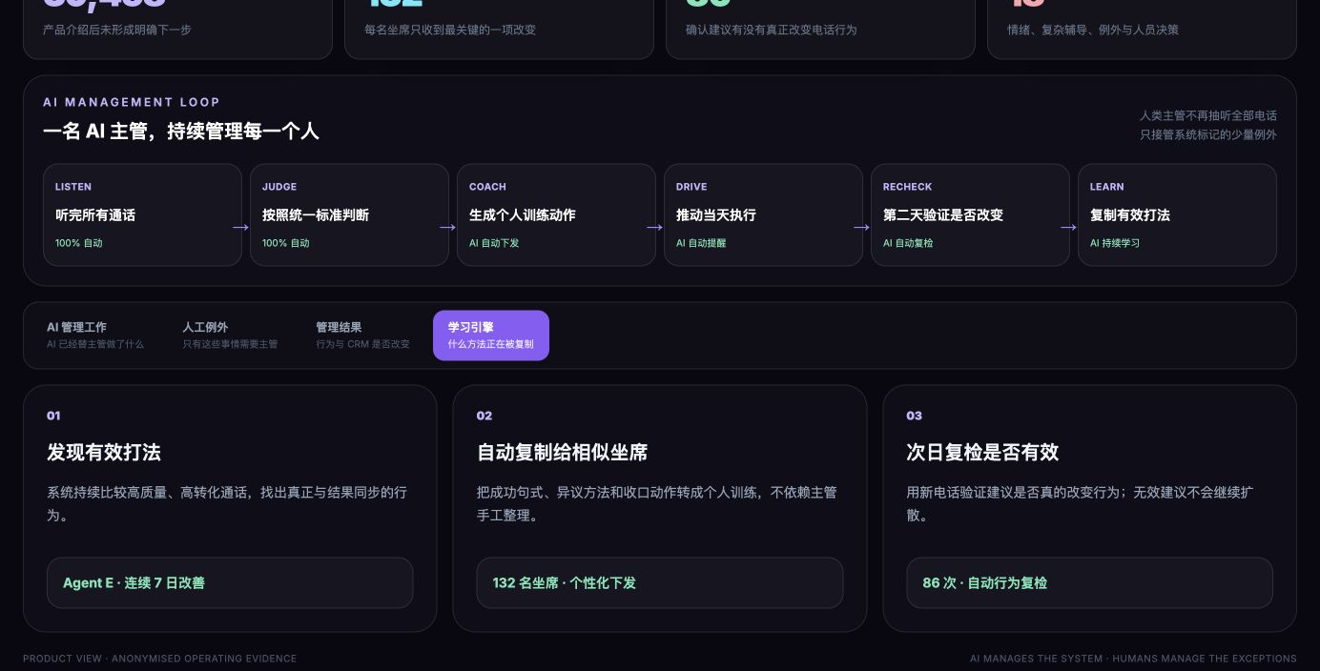
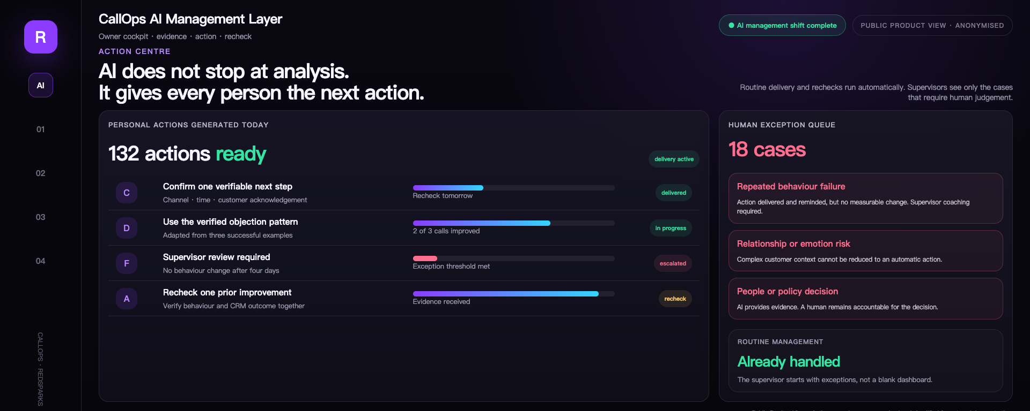
Redsparks / CallOps
ACTION CENTRE · AUTOMATED DELIVERY AND EXCEPTIONS
AI gives every person one concrete action. Supervisors handle only the exceptions that need judgement.
Public product view. Actions, execution status and recheck times are anonymised.
08
Notes:
[Sources]
- /Users/liuxue/Documents/Codex/callops-kuala-lumpur-talk/output/callops-kuala-lumpur-talk-cn-v8.2-proof-first-product-view-review.pptx

Slide 9
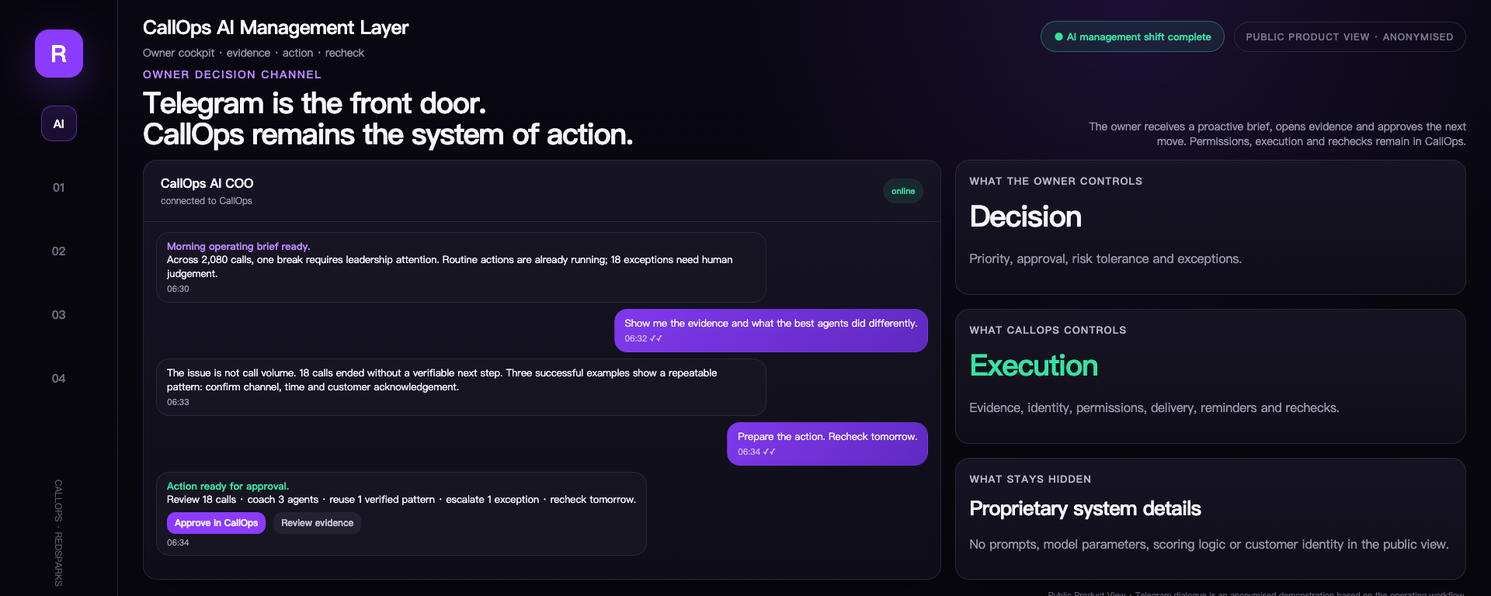
Redsparks / CallOps
TELEGRAM · OWNER DECISION ENTRY
Telegram helps the owner inspect and approve. CallOps owns the execution.
Proactive brief
Evidence drill-down
Owner approval
CallOps execution
09
Notes:
[Sources]
- /Users/liuxue/Documents/Codex/callops-kuala-lumpur-talk/output/callops-kuala-lumpur-talk-cn-v8.2-proof-first-product-view-review.pptx

Slide 10
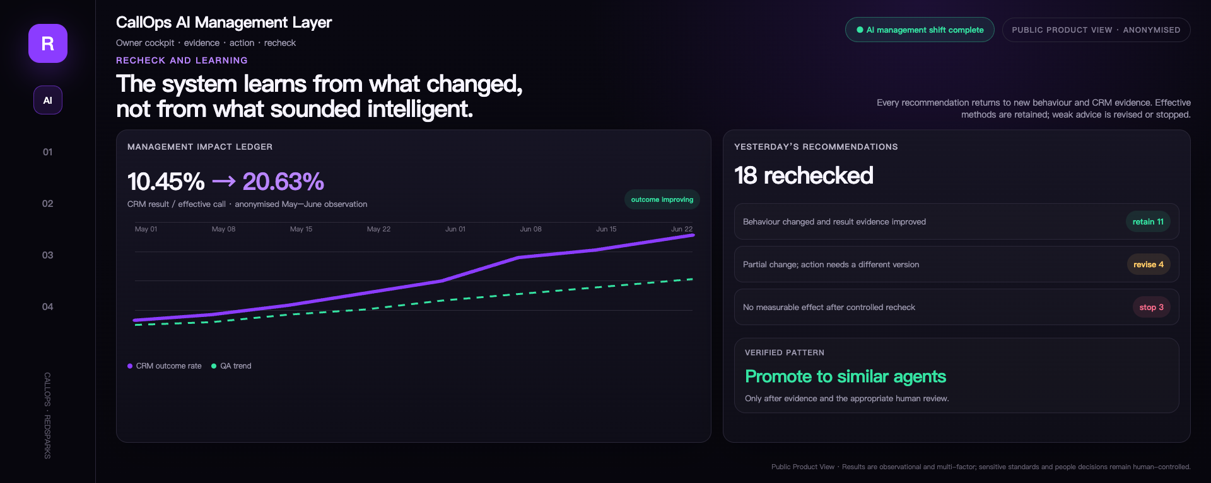
Redsparks / CallOps
RECHECK AND LEARNING · OPERATING IMPACT LEDGER
The system retains only methods that create measurable change. Ineffective advice is revised or stopped.
Anonymised observation · multi-factor outcomes · sensitive standards and people decisions remain human-approved.
10
Notes:
[Sources]
- /Users/liuxue/Documents/Codex/callops-kuala-lumpur-talk/output/callops-kuala-lumpur-talk-cn-v8.2-proof-first-product-view-review.pptx

Slide 11
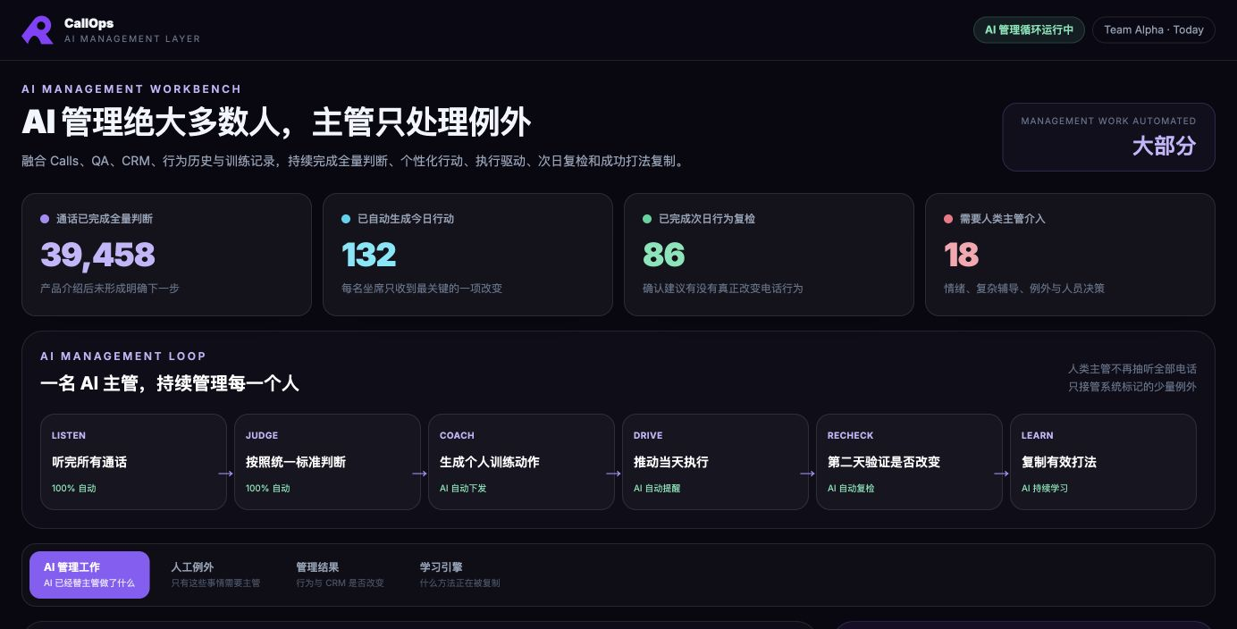
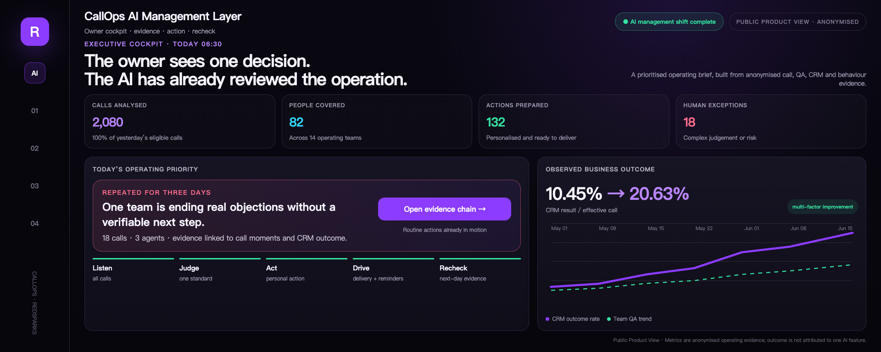
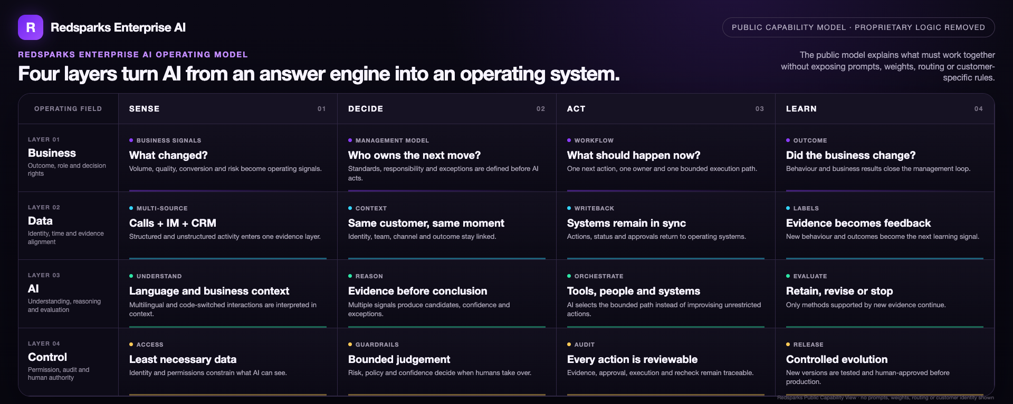
Redsparks / CallOps
CAPABILITY MODEL · ENTERPRISE AI
Enterprise AI is not one model. It is four system layers working together.
PUBLIC CAPABILITY MODEL · PROPRIETARY LOGIC REMOVED
BUSINESS × DATA × AI × CONTROL, ACROSS SENSE, DECIDE, ACT AND LEARN
11
Notes:
[Sources]
- /Users/liuxue/Documents/Codex/callops-kuala-lumpur-talk/output/callops-kuala-lumpur-talk-cn-v8.2-proof-first-product-view-review.pptx

Slide 12
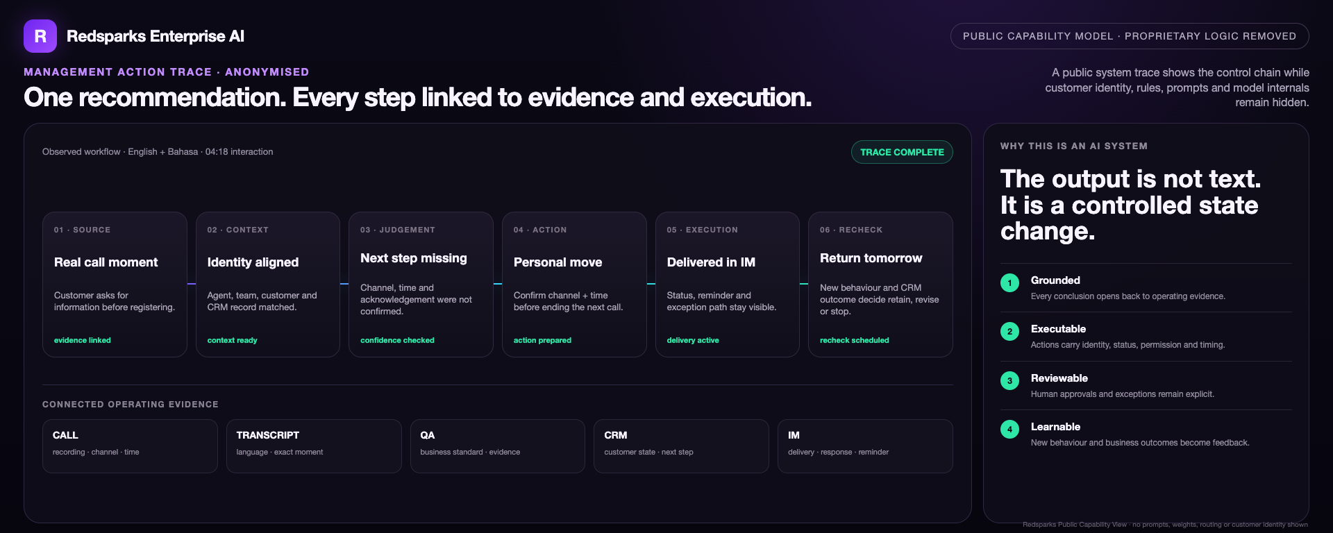
Redsparks / CallOps
SYSTEM PROOF · MANAGEMENT ACTION TRACE
Capability is not a polished answer. Every step must be traceable, executable and reviewable.
Traceable evidence
Executable actions
Auditable control
Reviewable outcomes
12
Notes:
[Sources]
- /Users/liuxue/Documents/Codex/callops-kuala-lumpur-talk/output/callops-kuala-lumpur-talk-cn-v8.2-proof-first-product-view-review.pptx

Slide 13
Redsparks / CallOps
REDSPARKS MOAT · MODEL-AGNOSTIC
Models will become cheaper. The enterprise AI operating system is hard to copy.
BUSINESS MODEL
+
DATA RELATIONSHIPS
Who owns it · which outcome · when to act
SYSTEM OF ACTION
LEARNING SYSTEM
SWAP THE MODEL
KEEP THE CAPABILITY
CRM · PBX · IM · permissions · approvals
Evidence · recheck · versioning · controlled release
Redsparks does not bet the operation on one foundation model. We place models inside a governed, executable and continuously improving enterprise system.
13
Notes:
[Sources]
- /Users/liuxue/Documents/Codex/callops-kuala-lumpur-talk/output/callops-kuala-lumpur-talk-cn-v8.2-proof-first-product-view-review.pptx

Slide 14
NEXT · CONTROLLED EXPANSION
AI will not stop at managing calls.
It will run the daily operation of the entire customer interaction chain.
IM behaviour management · real-time assistance
Authorised AI calling · cross-system execution
Every new capability still passes pilot, permission, approval and compliance gates. AI expands execution; it does not remove human accountability.
Notes:
[Sources]
- /Users/liuxue/Documents/Codex/callops-kuala-lumpur-talk/output/callops-kuala-lumpur-talk-cn-v8.2-proof-first-product-view-review.pptx

Slide 15

Redsparks / CallOps
CallOps is one proof point.
Complex operations can become AI systems that run and learn.
Redsparks solves large, complex operations that still depend on people holding the process together.
If your enterprise has a critical workflow held together by manual effort, we can redesign it together.
Sean Liu · Founder & CEO, Redsparks
SCAN · TEST THE AI RESPONSE · CONNECT
Notes:
[Sources]
- /Users/liuxue/Documents/Codex/callops-kuala-lumpur-talk/output/callops-kuala-lumpur-talk-cn-v8.2-proof-first-product-view-review.pptx

